Slide 1



Maze Solver with DDPG and HGR
Student:
Francesco Saverio Conforti (1892548)
Prof: Roberto Capobianco
Teacher Assistant: Federico Di Valerio
Course: Reinforcement Learning

Slide 2
Introduction to the problem
Context
Navigation of an agent through a maze from a start position to a goal.
The state space is defined by agent position, goal, and obstacles.
Discrete actions (e.g., move up, down, left, or right).
Positive rewards for reaching the goal, penalties for inefficiency
To find the optimal sequence of actions to reach the goal efficiently.
Also used in robotics
Challenges
State space dimensions increases rapidly with maze size
Rewards are rare, making learning difficult.
Balancing new path exploration with known paths
Difficulty in finding convergence
The agent may learn specific mazes without generalizing to new ones.

Slide 3
System Overview
Agent:
Learns optimal policies to navigate the maze.
Learning Paradigm:
Deep Reinforcement Learning (DRL)
Replay Buffer:
Hindsight Goal Ranking (HGR) to prioritize learning from high-error experiences.
Custom maze environment with:
Dynamic size and obstacles
State space represented as a 3-channel grid
Discrete action space: up, down, left, right.

Slide 4
Model overview
Actor Network
Learns a policy for selecting actions.
updates the policy using feedback from the Critic
Critic Network
Estimates the value function or action-value function , which evaluates the quality of actions
minimizes the error in value estimation

Slide 5





Learning Process
Actor Update
Uses the policy gradient theorem
Critic Update
Minimizes the Temporal Difference (TD) error
Loss: Mean Squared Error (MSE)

Slide 6


Sac Key feature
Entropy Regularization for Exploration
Double Critics for Stabilization

Slide 7
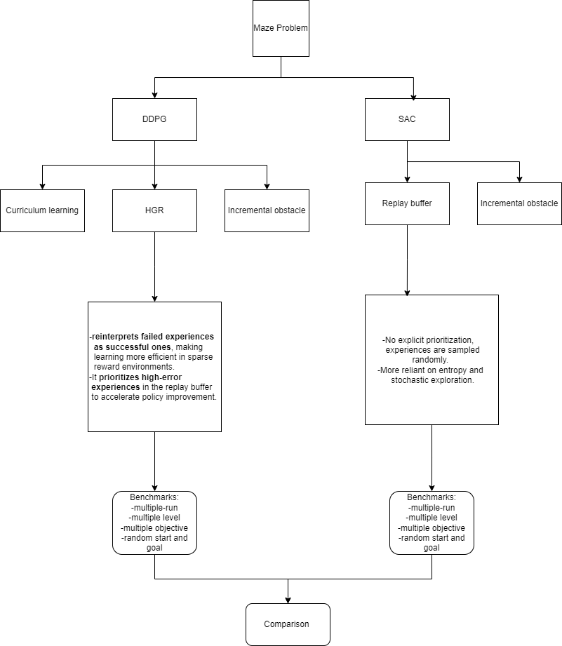

Slide 8
Benchmarks
Multi-objective maze test
Multi-level maze test
Multi run success rate
Comparison with sac model

Slide 9
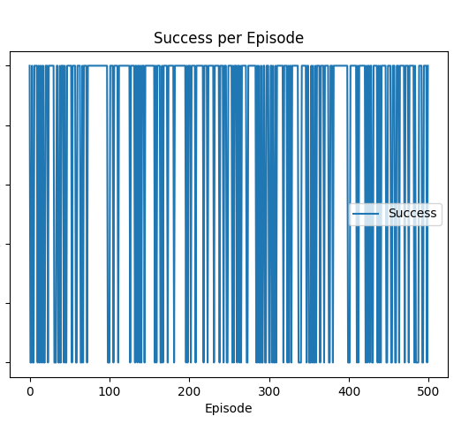
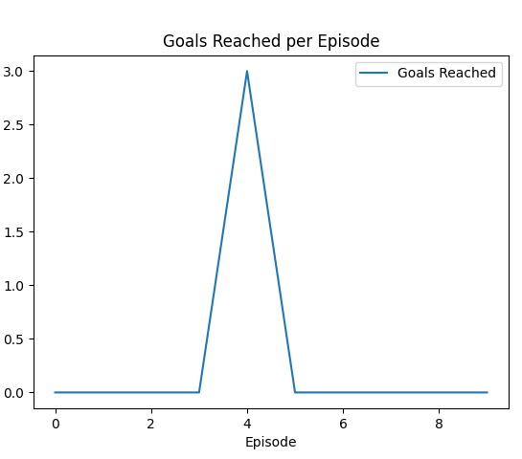
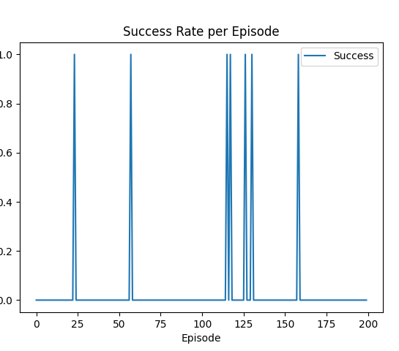
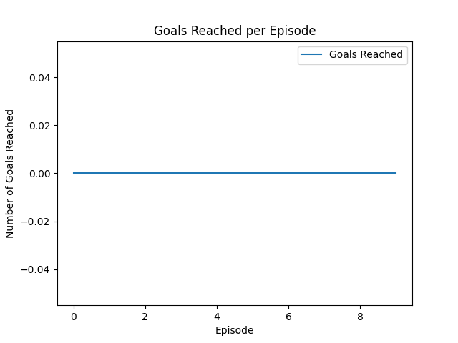
Results
HER:
shows a clear spike in goals reached during specific episodes.
HER's reinterpretation of failed experiences as successes improves multi-level learning, resulting in consistent goal achievement.
SAC:
struggles with fewer goals reached, likely due to its reliance on entropy-based exploration rather than goal reinterpretation.

Slide 10
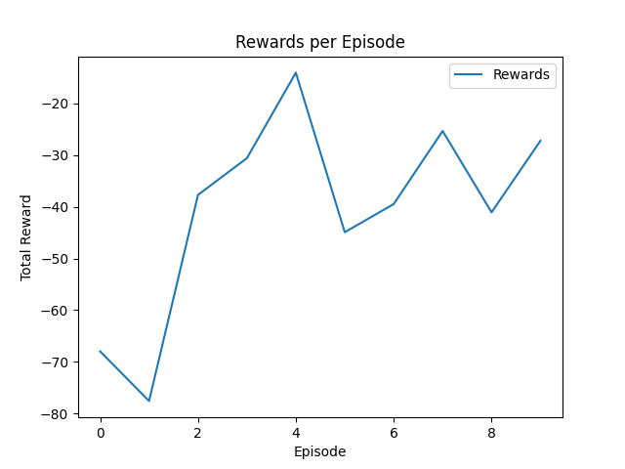
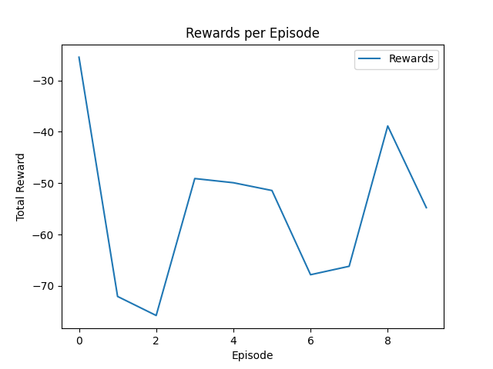
Rewards per Episode
HER:
has smoother reward accumulation, reflecting consistent learning across episodes.
It demonstrates a clear advantage in sparse reward settings, leveraging its ability to reuse experiences effectively.
SAC:
shows fluctuations and slower reward accumulation, likely caused by challenges in sparse reward environments.

Slide 11
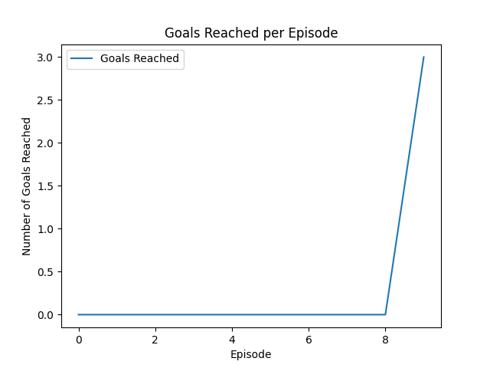
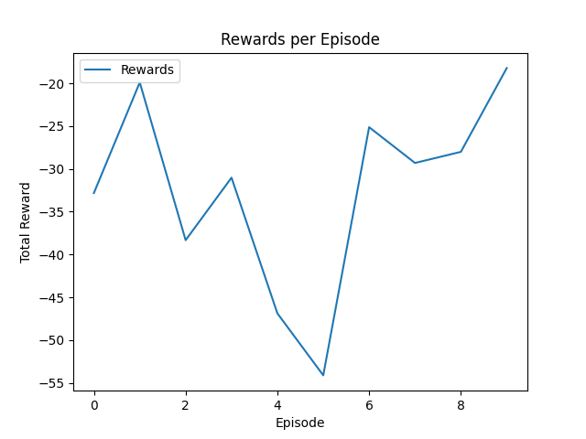
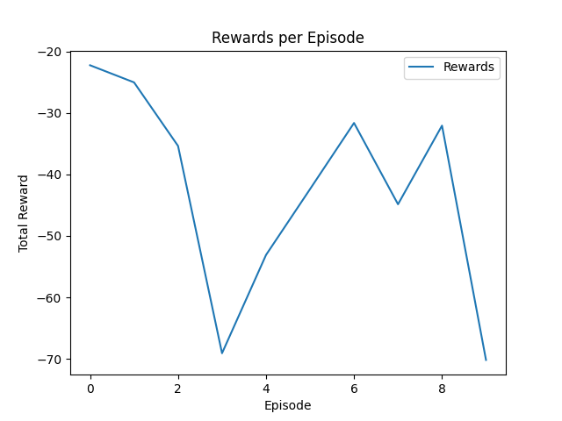
Multi objective runs

Slide 12
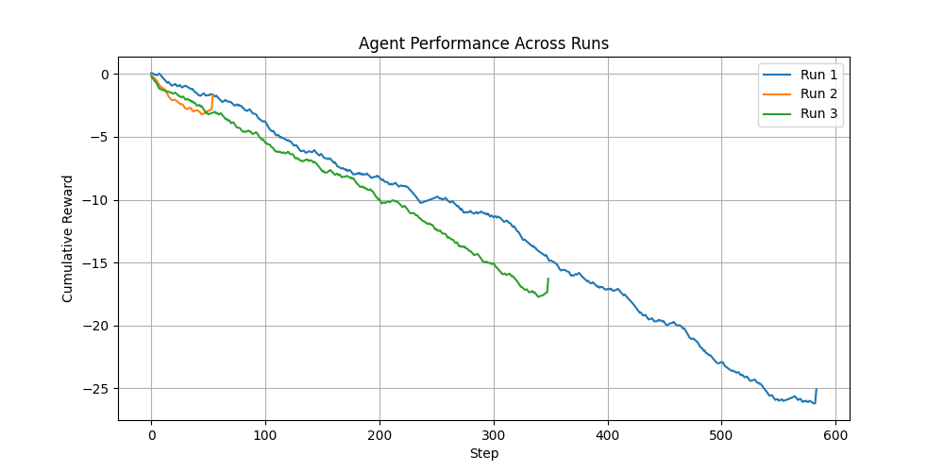
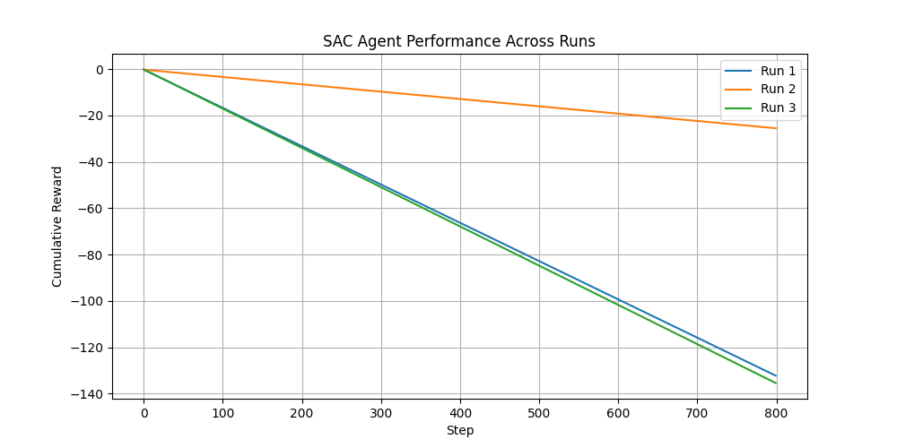
Performances across three runs of DDPG and SAC

Slide 13
Conclusion
HER's Advantage:
Excels in sparse reward and multi-objective environments by reinterpreting failures and reducing the number of steps required to reach goals.
More stable and consistent across runs.
SAC's Strength:
Performs well in dense reward environments but struggles in settings with high variability or sparse feedback.

Slide 14



Future Improvements
Adaptive Exploration Strategies :Encourage exploration based on curiosity-driven rewards, e.g., novelty of states visited.
Curriculum Learning Enhancements
Reward Shaping

Slide 15



Thank you for the attention! Questions?

